Slide 1
Employee Payroll Management System
Group - 2

Slide 2
Group 2-Team members
2528029 - Archatha R
2527533 - Arpit Saxena
2528037 - Aswin Kumar Madhavan
2526901 - Atla Harinath Reddy
2526772 - Atte Dilip
2528132 - Balusu Manikoushika
2527555 - Barath C
2527902 - Bayye Priyadarshini
2528669 - Bharath Ravindran
2530057 - Chirag Agarwal

Slide 3
Contents
01
02
03
05
06
07
04
INTRODUCTION
OBJECTIVE
SYSTEM REQUIREMENT
TOOLS & LANGUAGES USED
08
FEATURES
APP FLOW
E-R DIAGRAM
ADVANTAGES
09
10
11
12
WORKING OF PROJECT
JUNIT TESTING-OUTPUT
POSTMAN TESTING-OUTPUT
CONCLUSION

Slide 4
INTRODUCTION
01

Slide 5
Introduction
Employee payroll management system is an Internet-based Java application that automates the working of a company or work center that manage and maintain records of the employees leaves, work, attendance and salary.
Payroll System is compatible with existing back-end systems to handle the heavy lifting of calculating time, wages and attendance reports while simultaneously maintaining compliance.
This web application is reduced as much as possible to avoid errors while entering data. It also provides error message while entering invalid data.

Slide 6
Objective
The Primary objective of the design is to deliver the requirement as delivered by the feasibility report. There are some objective we kept in mind.
Practically : The system is quite stable and can be operated by the Employees with average intelligence.
Efficiency : We tried to improve accuracy and productivity.

Slide 7
Tools & Languages
FRONT END
BACK END
Visual Studio
Angular
HTML
CSS
BOOTSTRAP
Spring Tool Suite
MySQL
Spring boot
Postman
Junit

Slide 8
Features
User friendly.
This system is easily compatible with most of the web browsers.
Features include the following:
EMS (Employee Management System)
WSS (Work Scheduling System)
AMS (Attendance Management System)
LMS (Leaves Management System)
SMS (Salary Management System)

Slide 9
Advantages
Helps the admin easy way to access the employee data
The information related to employee can be added and removed easily
Store the end-to-end data of the employees
Helps the employee easy way to access their data

Slide 10
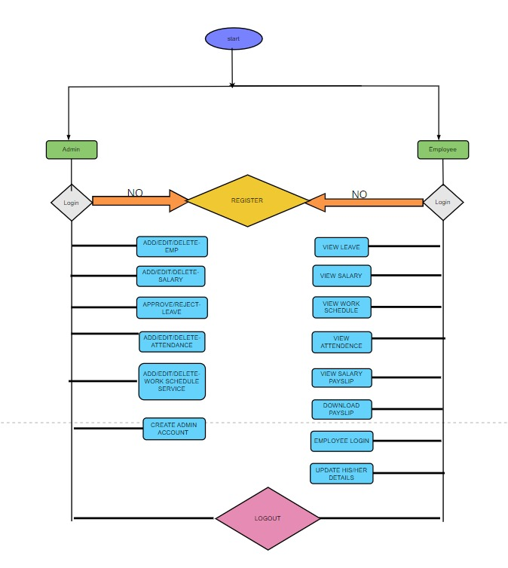
APP FLOW

Slide 11
Working of the project
Admin login
Admin can enter the application by entering valid credentials.
If entered credentials are invalid then it will show invalid credentials.
Validation will be checked only if both the fields are filled.
After login successfully admin can fetch the entire data.
Admin also have the authority to create new admin by clicking on new admin button.

Slide 12
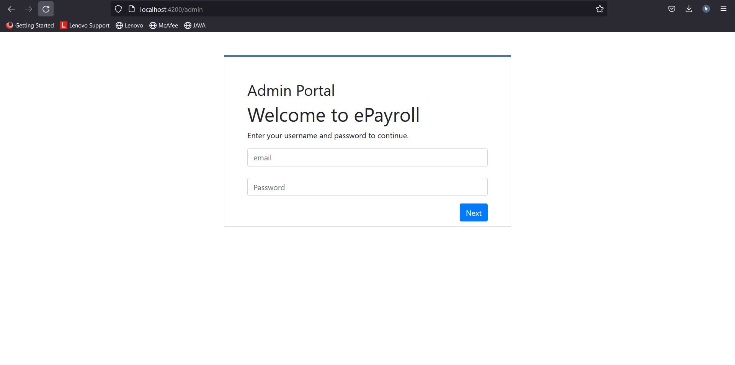
Admin Login

Slide 13
New admin
Admin will add a new admin by entering new email and password in the add admin page.
New admin can be created by assigning him credentials(email and password).
Now this new admin can also login to E-payroll management system by entering valid credentials and can navigate to the dashboard.

Slide 14
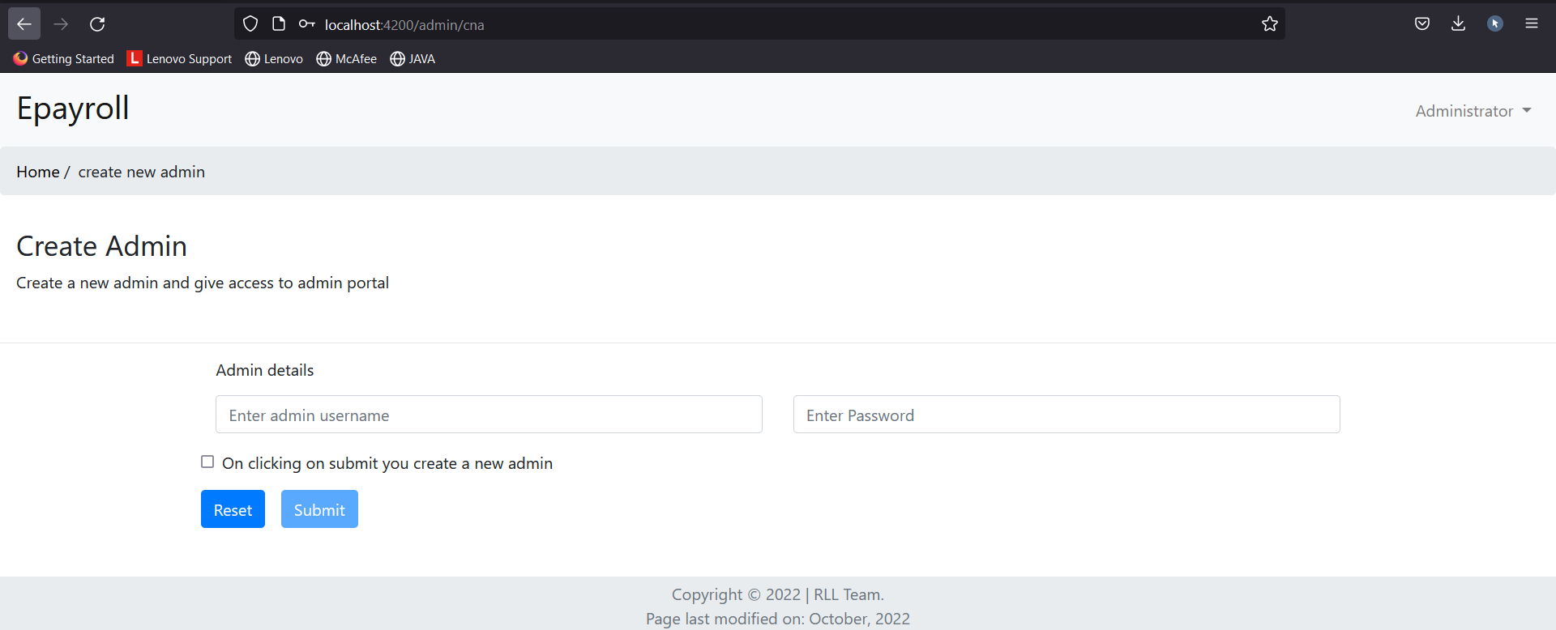
Create New Admin

Slide 15
Admin Dashboard
In the admin dashboard, there are 5 components which perform respective functionality,they are:
EMS (Employee Management System)
WSS (Work Scheduling System)
AMS (Attendance Management System)
LMS (Leaves Management System)
SMS (Salary Management System)

Slide 16
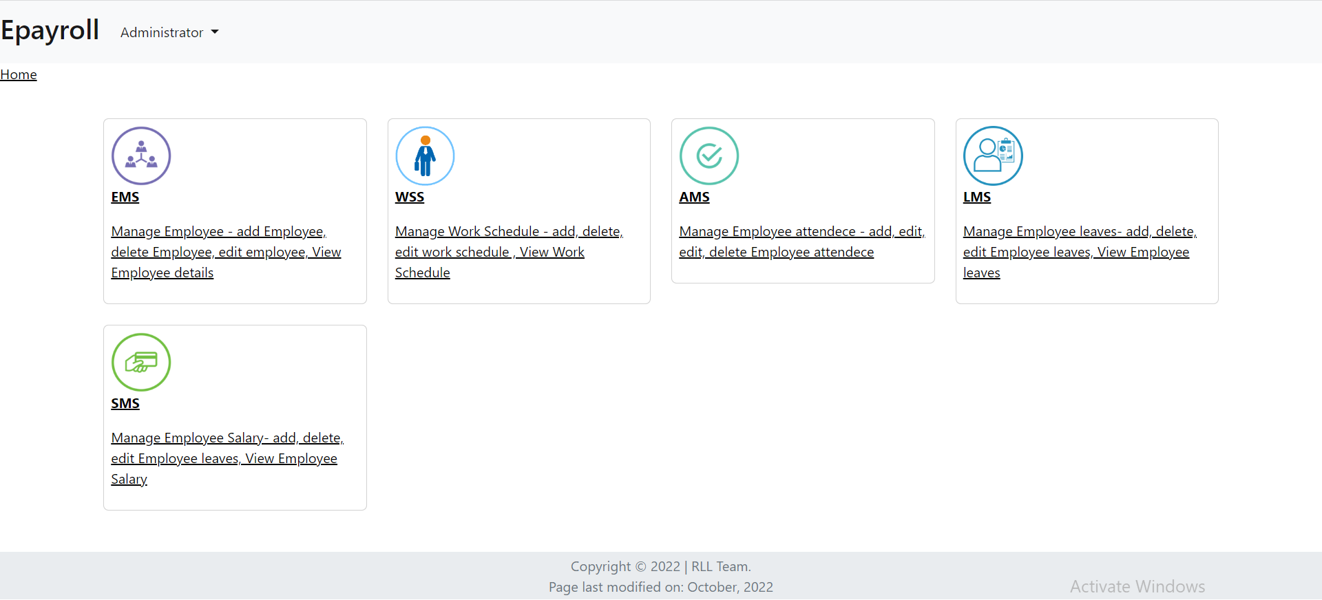
Admin Dashboard

Slide 17
Employee Management System
Add Employee:
The platform has features to build and add employee details such as Employee’s First Name, Last Name, Password, Designation, Gender, Email, Phone Number and Date Of Joining.
Edit Employee:
The platform has feature to edit employee details such as Employee’s First Name, Last Name, Email, Designation, Gender and Date Of Joining.
Delete Employee:
The platform has feature to delete employee details.

Slide 18
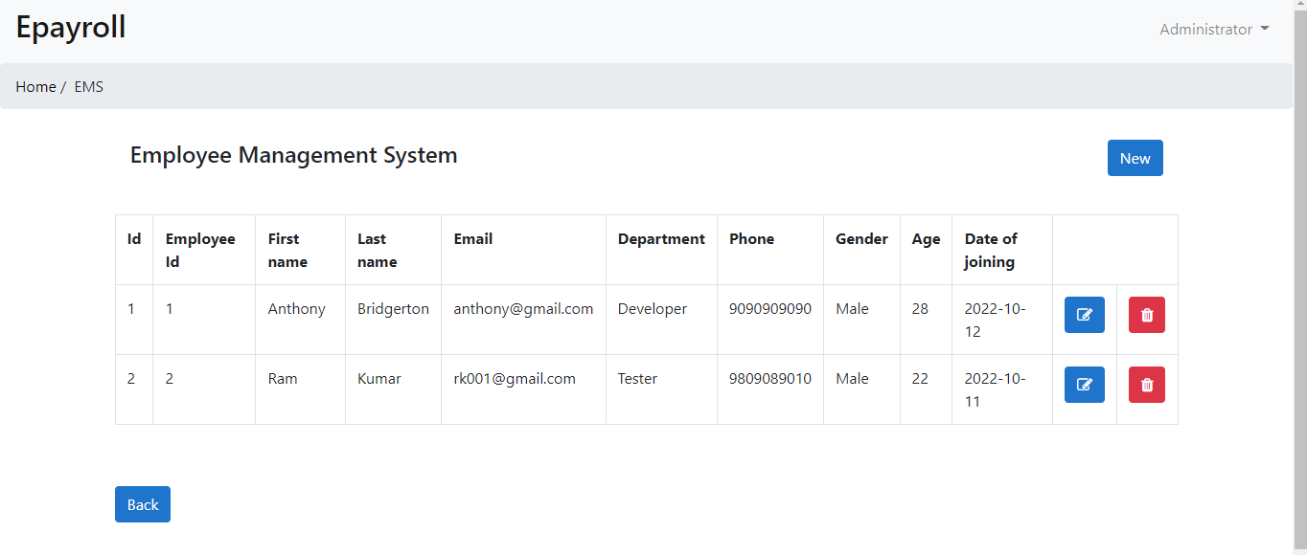
EMS

Slide 19
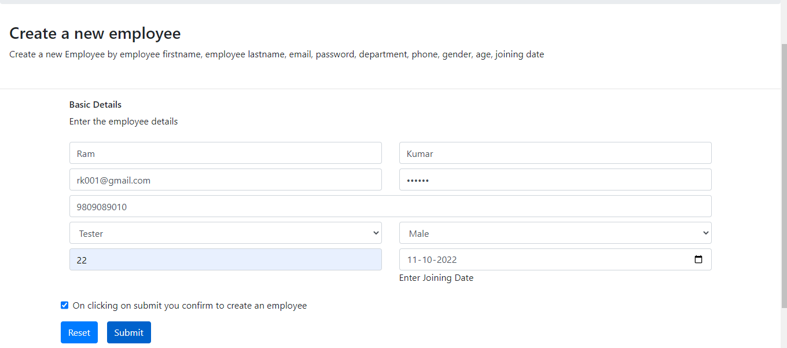
Add Employee

Slide 20
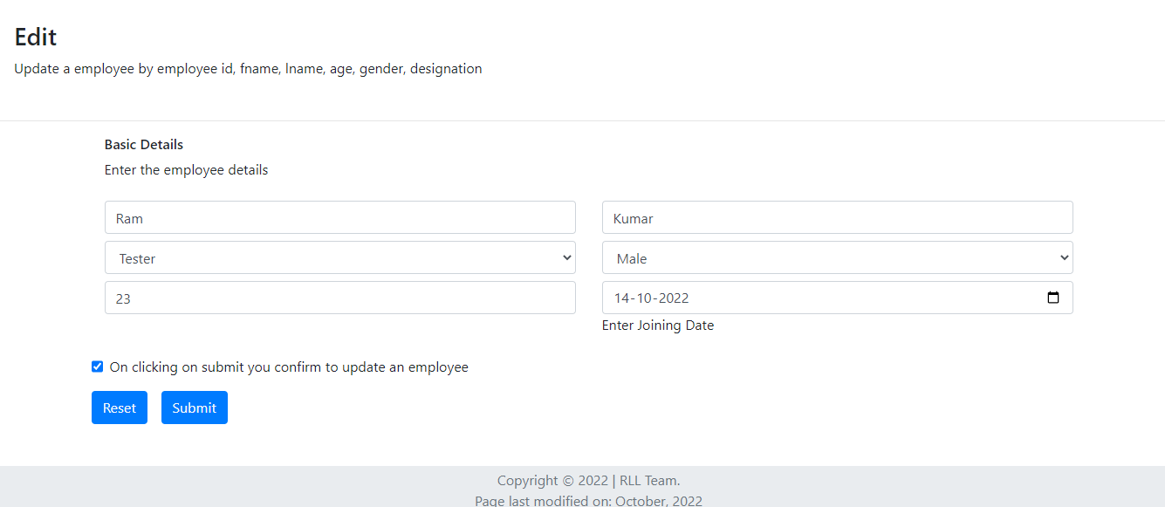
Edit Employee

Slide 21
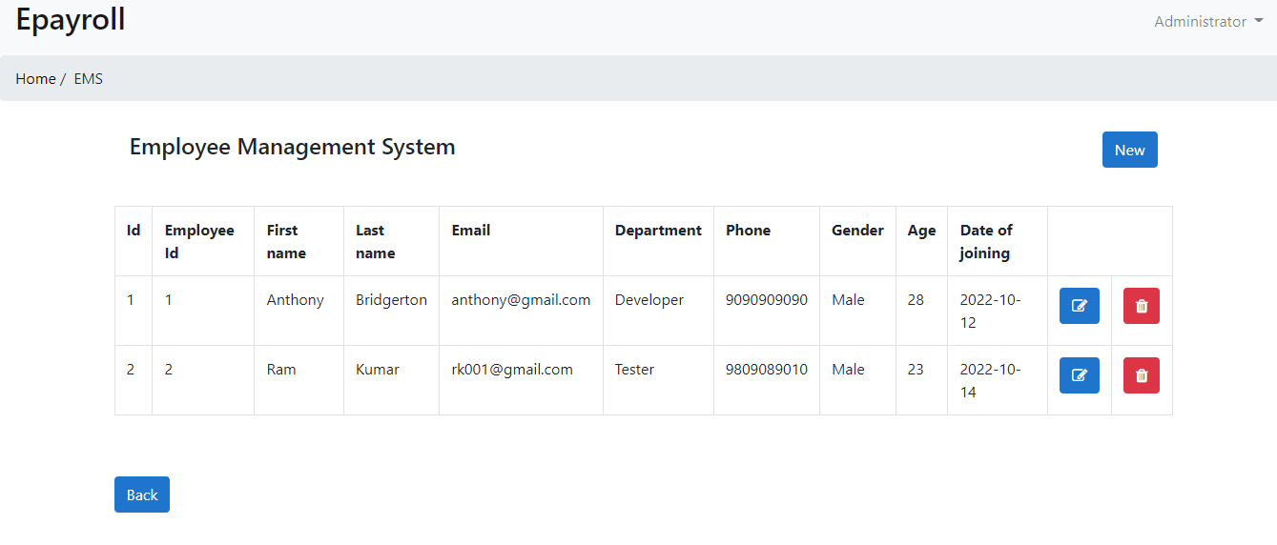

Slide 22
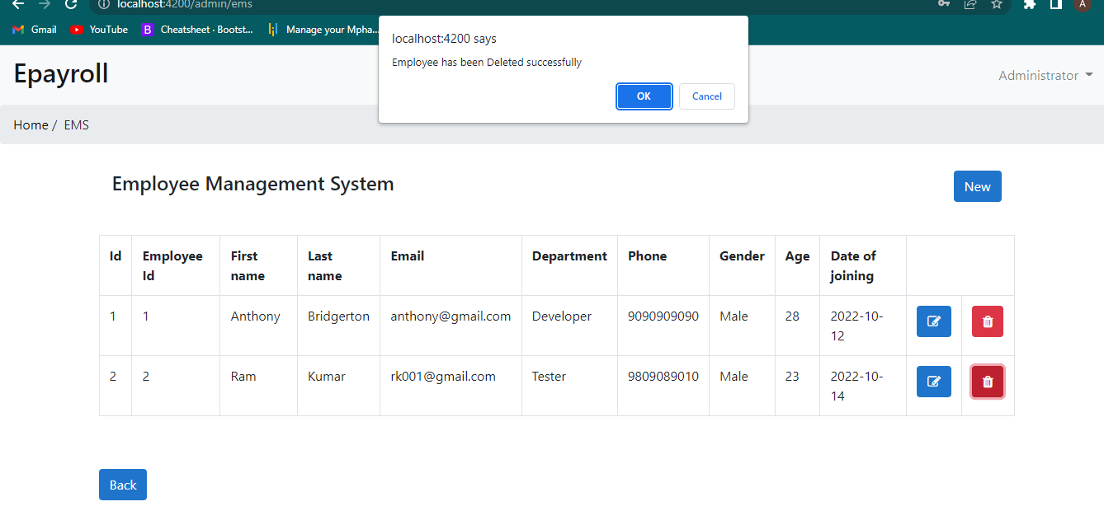
Delete Employee

Slide 23
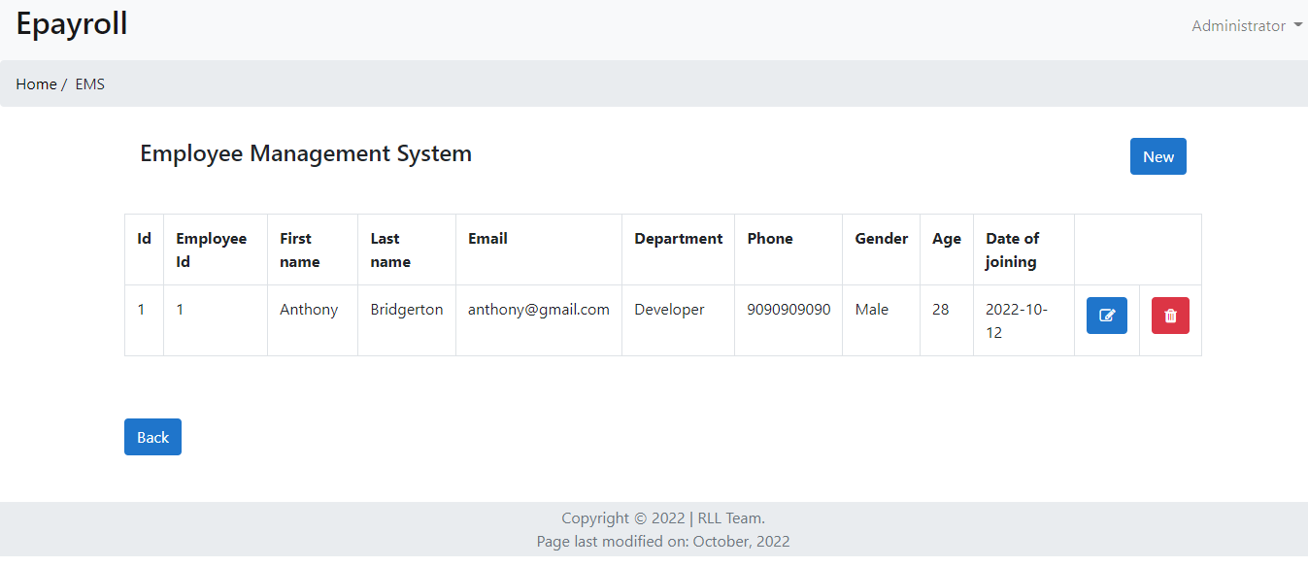

Slide 24
Work Schedule System (WSS - Admin)
Features of WSS - Admin:
View/Add/Edit/delete the work schedule
On the main page of WSS, admin can view all the work schedules created for the employee and also consists of buttons to go to add WSS, edit WSS and delete WSS
On clicking add button admin can add the Work Schedule details like Work title, work description, work start date, work end date, status and can choose the email of employee to assign the work
On clicking on edit button admin can edit the details of work scheduled to the employee.
On Clicking on delete button admin can delete the specific work schedule.

Slide 25
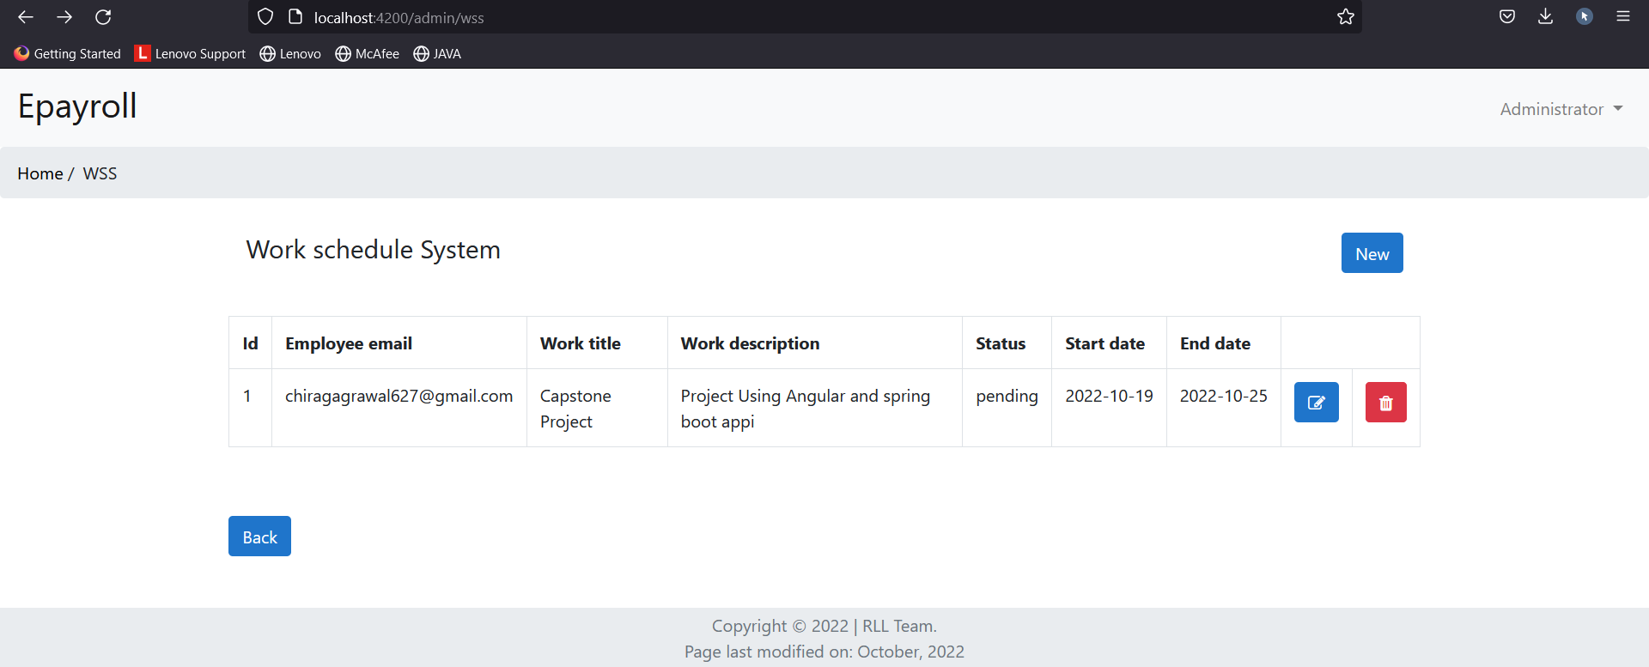
View Work Schedule System (WSS - Admin)

Slide 26
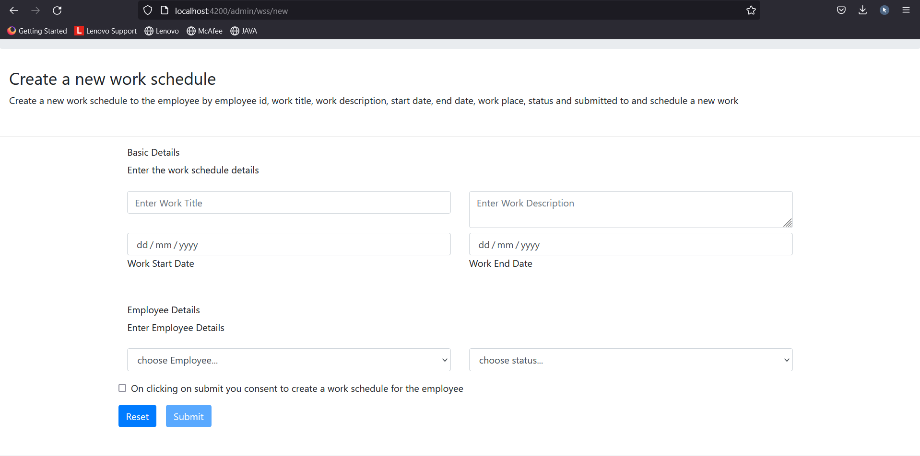
Add Work Schedule System (WSS - Admin)

Slide 27
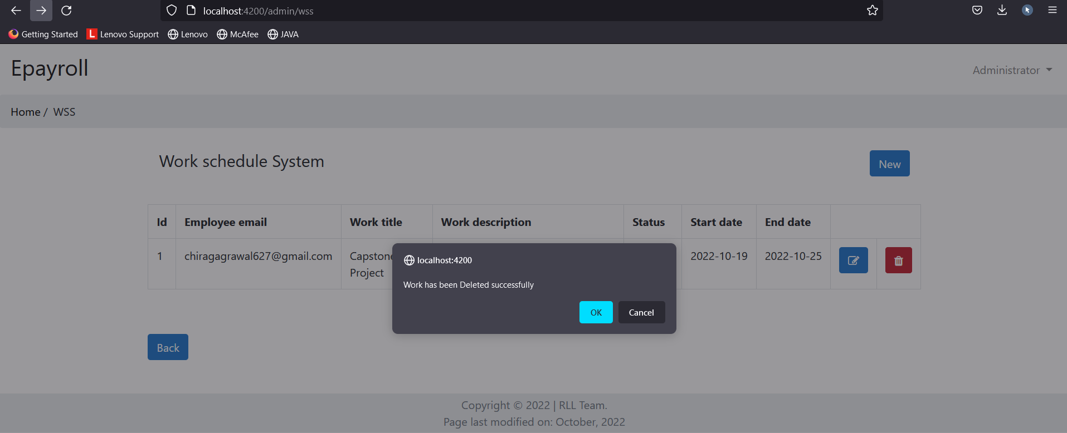
Delete Work Schedule System (WSS - Admin)

Slide 28
Attendance Management System (AMS - Admin)
Features of AMS - Admin:
View/Add/Edit/delete the employee attendance
On the main page of AMS, admin can mark the attendance of the employees for those who have logged in to the employee site and also the page consists of buttons to go to add,edit and delete AMS.
On clicking add button admin can add the attendance details like employee id, employee email, attendance date and status that either present or absent.
On clicking on edit or update button admin can edit the status of employee attendance.
On Clicking on delete button admin can delete the particular employee attendance details.

Slide 29
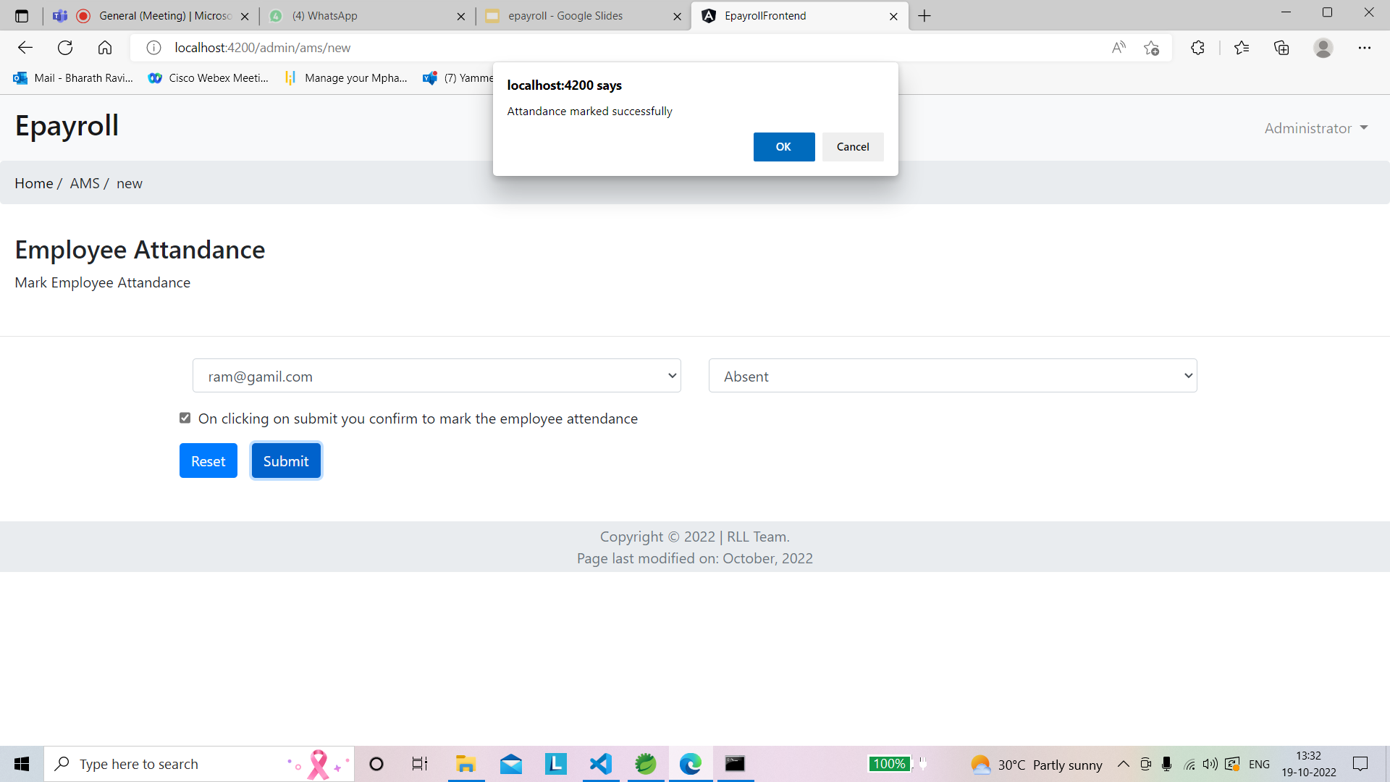
Add Attendance Management System (AMS - Admin)

Slide 30
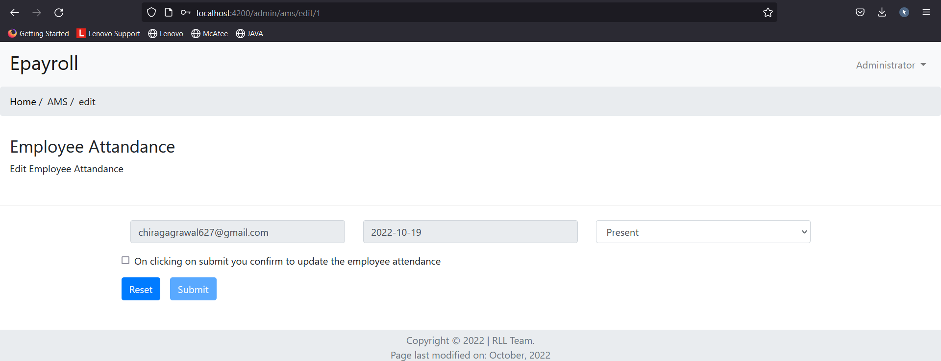
Edit Attendance Management System (AMS - Admin)

Slide 31
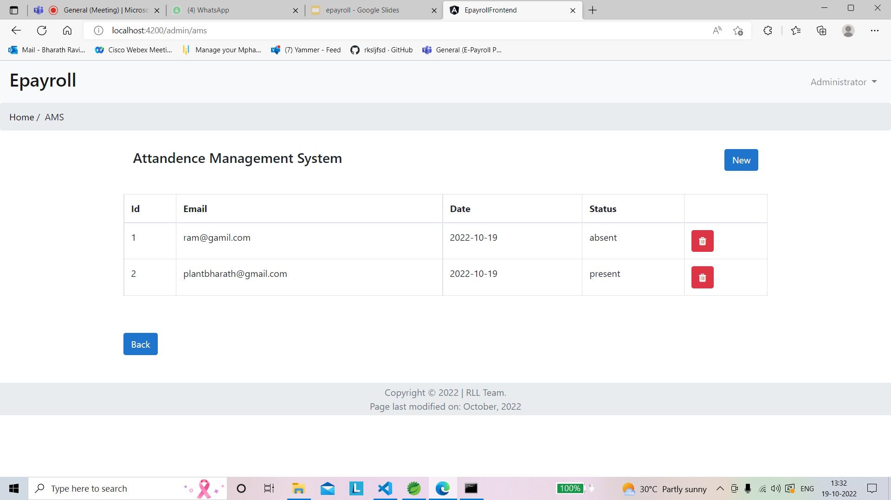
View Attendance Management System (AMS-Admin)

Slide 32
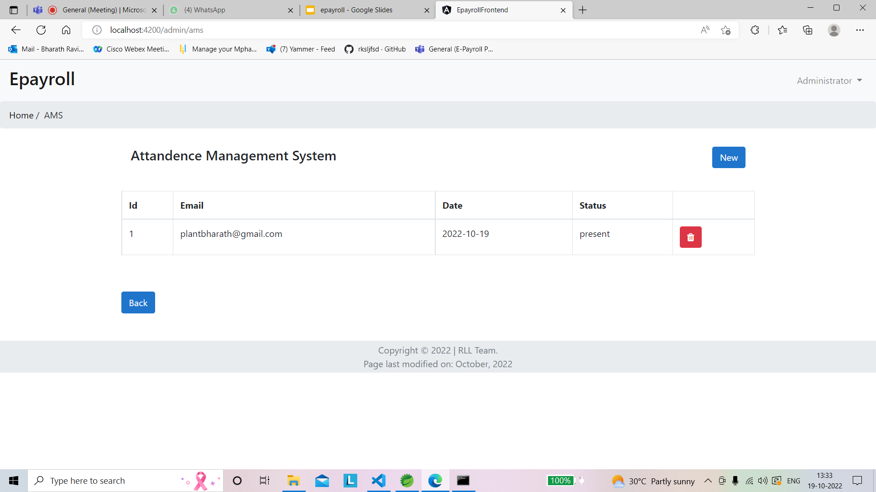
Delete Attendance Management System (AMS-Admin)

Slide 33
Leave Management System (LMS-admin)
Features of LMS - Admin:
View Leaves from different Employees/Approve or reject
On the main page of lms admin can view all the Leave Requests from the different Employees.
The Admin can see the reasons of leave and the leave dates of Employee
i.e,duration.
Admin has two buttons one is Approve and other is Reject .
On Clicking on Approve button admin can accept the leave of employee orelse when he click Reject button the leave of employee gets rejected.

Slide 34
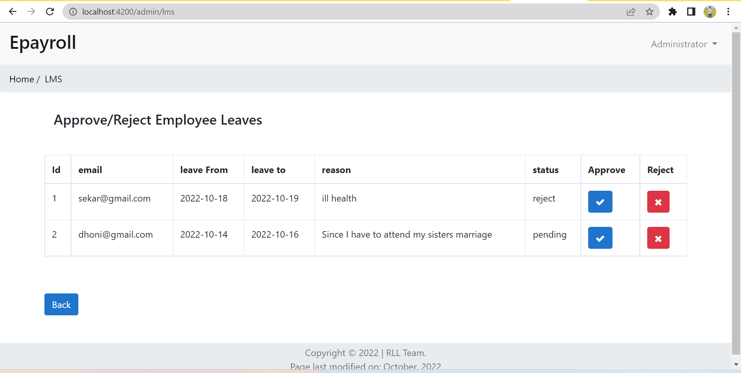
Leave Management System (LMS-admin)

Slide 35
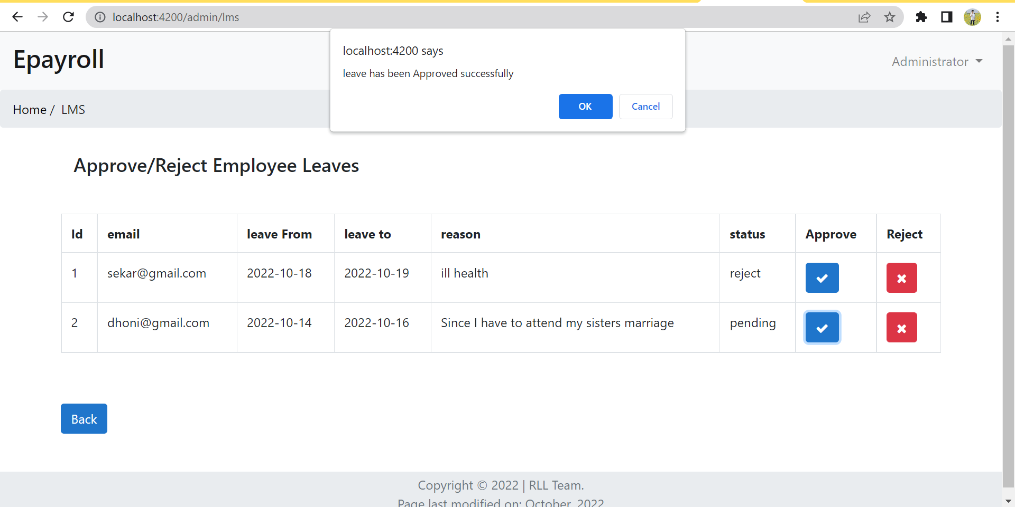
Leave Management System (LMS-admin)

Slide 36
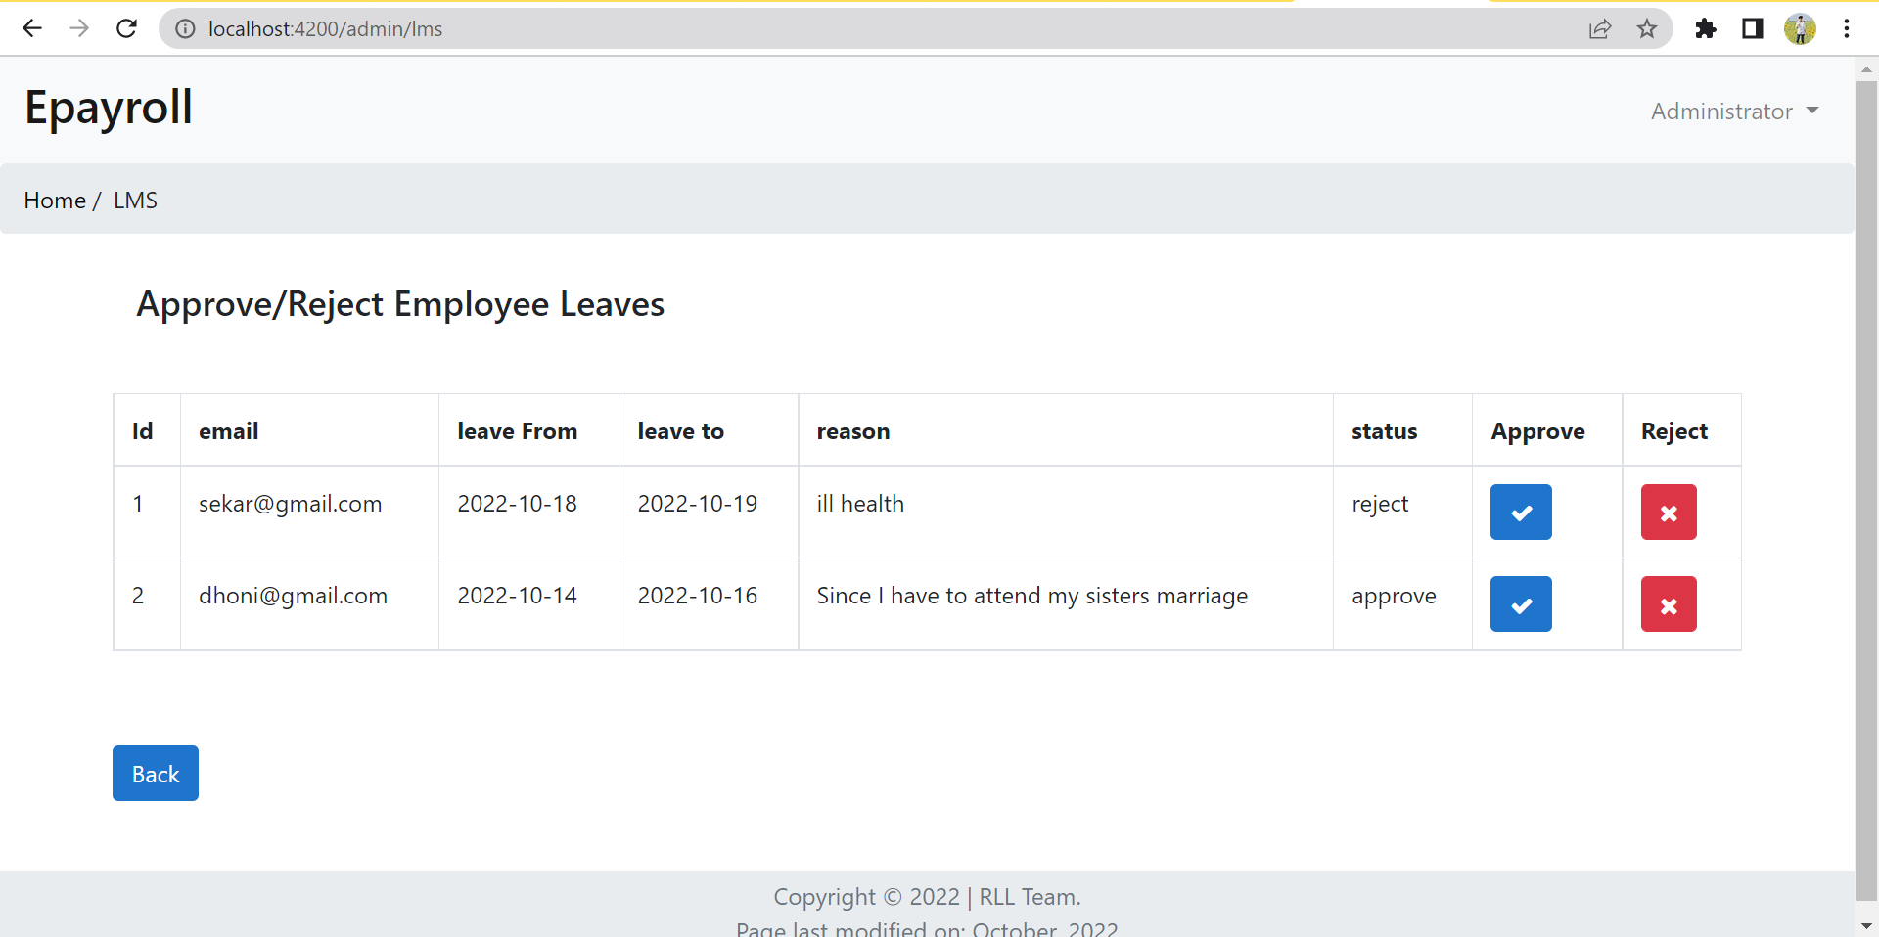
Leave Management System (LMS-admin)

Slide 37
Salary Management system (SMS -admin)
Features :Add/Edit/Delete the Salary of the employee.
Main page of admin portal of salary management system shows the existing employees salary along with their respective email.
Admin is able to create new employee salary by clicking on the button “new” provided in the main page.This will redirect admin to a new page where he can add salary for the existing employees.
There is also edit icon provided in the main page to edit the salary and delete icon to delete the salary.

Slide 38
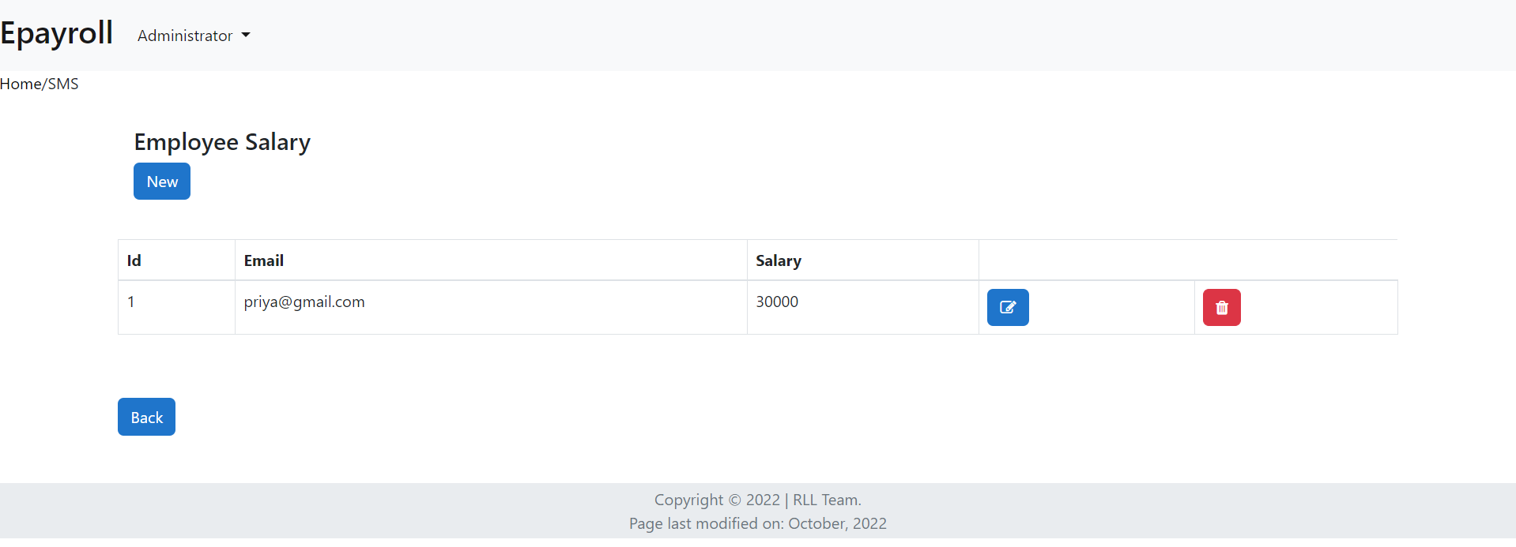
Salary Management system (SMS -admin)

Slide 39
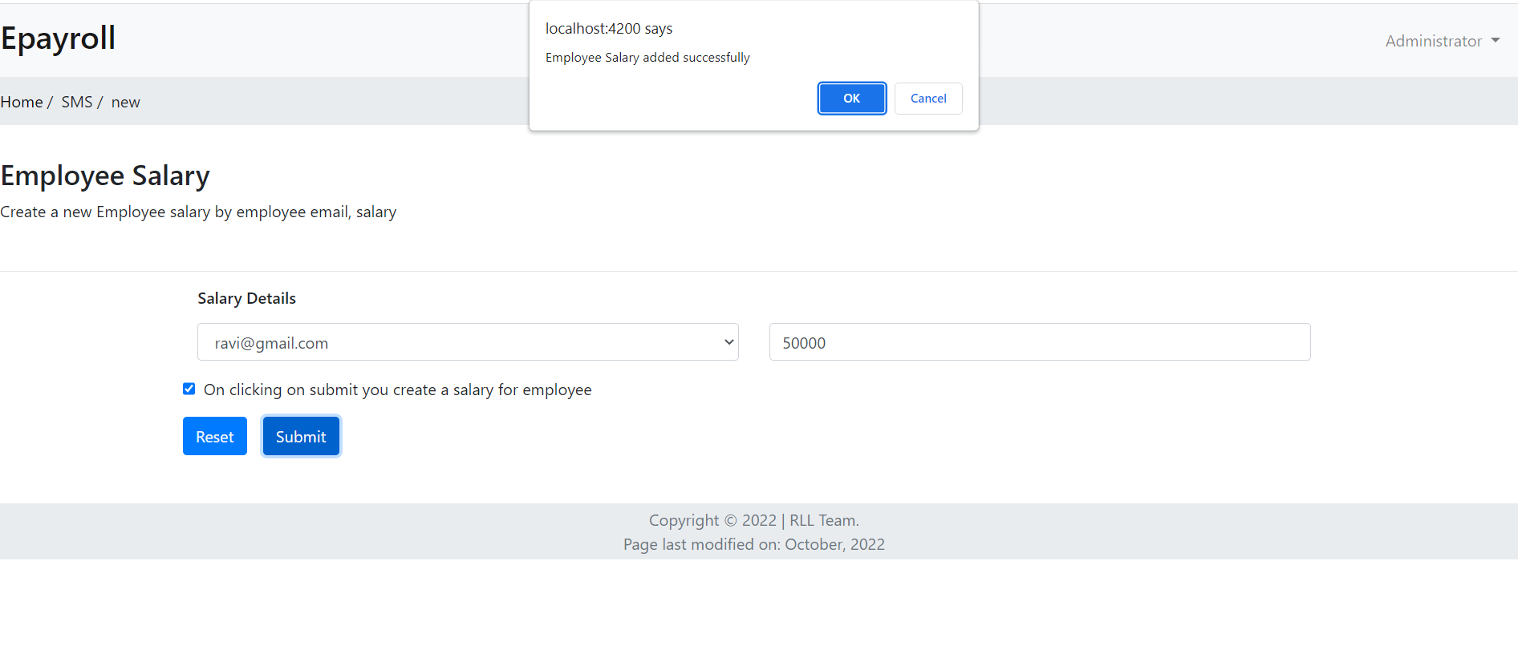
Salary Management system (SMS -admin)
Salary creation for new employee by admin

Slide 40
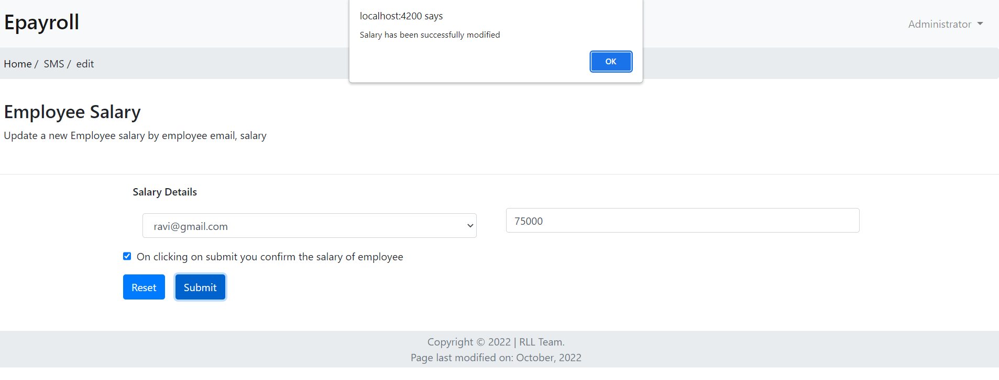
Salary Management system (SMS -admin)

Slide 41
Employee signup
New employee can register themselves by providing basic details like name, date of joining, gender, age, designation, email id, salary and password.
After filling all the fields, employee will click on the register button and will get registered.
Now the employee can login the application with appropriate credentials like email and password.

Slide 42
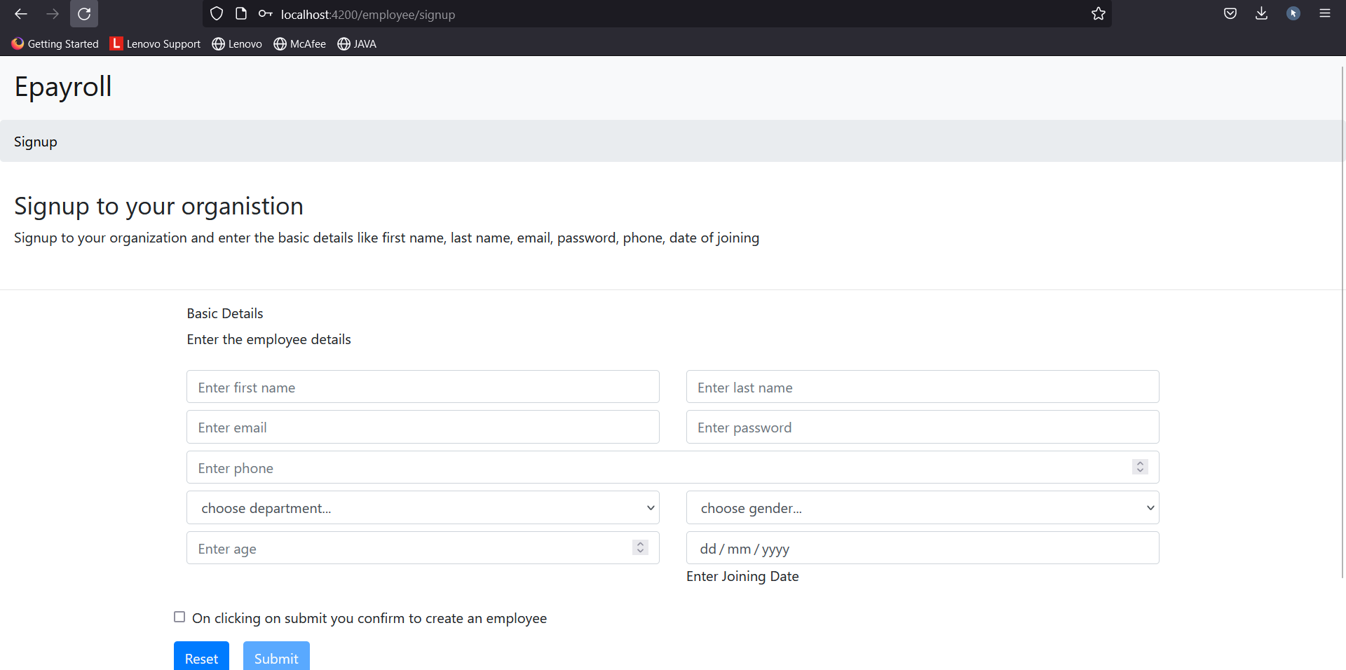
Employee signup

Slide 43
Employee sign in
To fetch the employee details, the specific employee will have to login in the employee portal.
Employee need valid credentials for successful login.
If the credentials are wrong then the system will show login failed.
Forgot password option is also available if in case registered employee forgets his/her password.

Slide 44
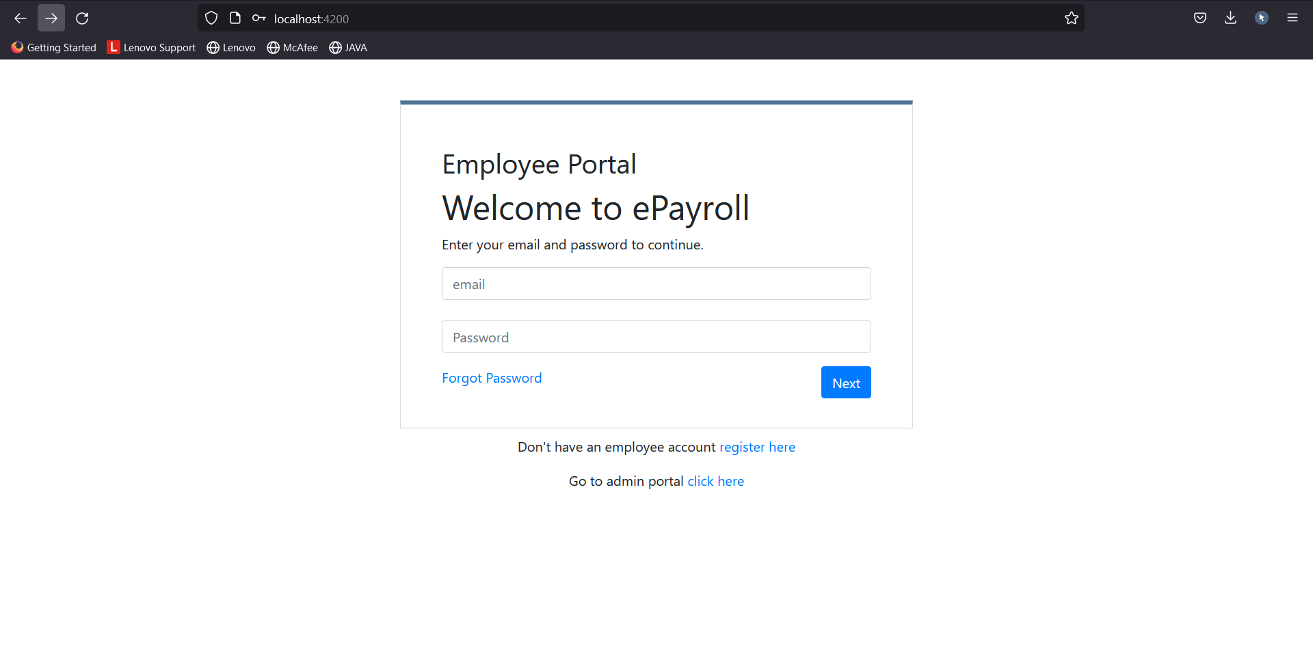
Employee signin

Slide 45
Employee Forgot password
In forgot password page, employee has to provide his email, phone number and a new password.
If the email and phone number of the the employee matches then the new password given is updated.
If the email and phone number of the employee doesn’t match to any account then the system shows error.
Once the employee has reset the password successfully then employee can login into the employee portal by giving the email and new password which he has created.

Slide 46
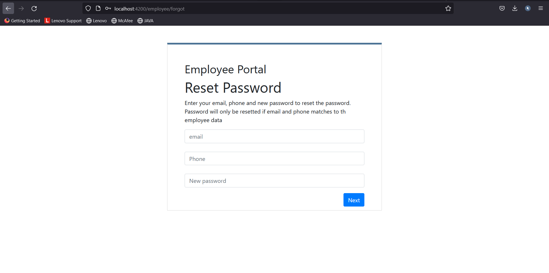
Employee Forgot password

Slide 47
Employee Dashboard
After successful login of employee, there will be a dashboard with 4 main components that can perform respective functionality.
They are:
WSS (Work Scheduling System)
AMS (Attendance Management System)
LMS (Leaves Management System)
SMS (Salary Management System)

Slide 48
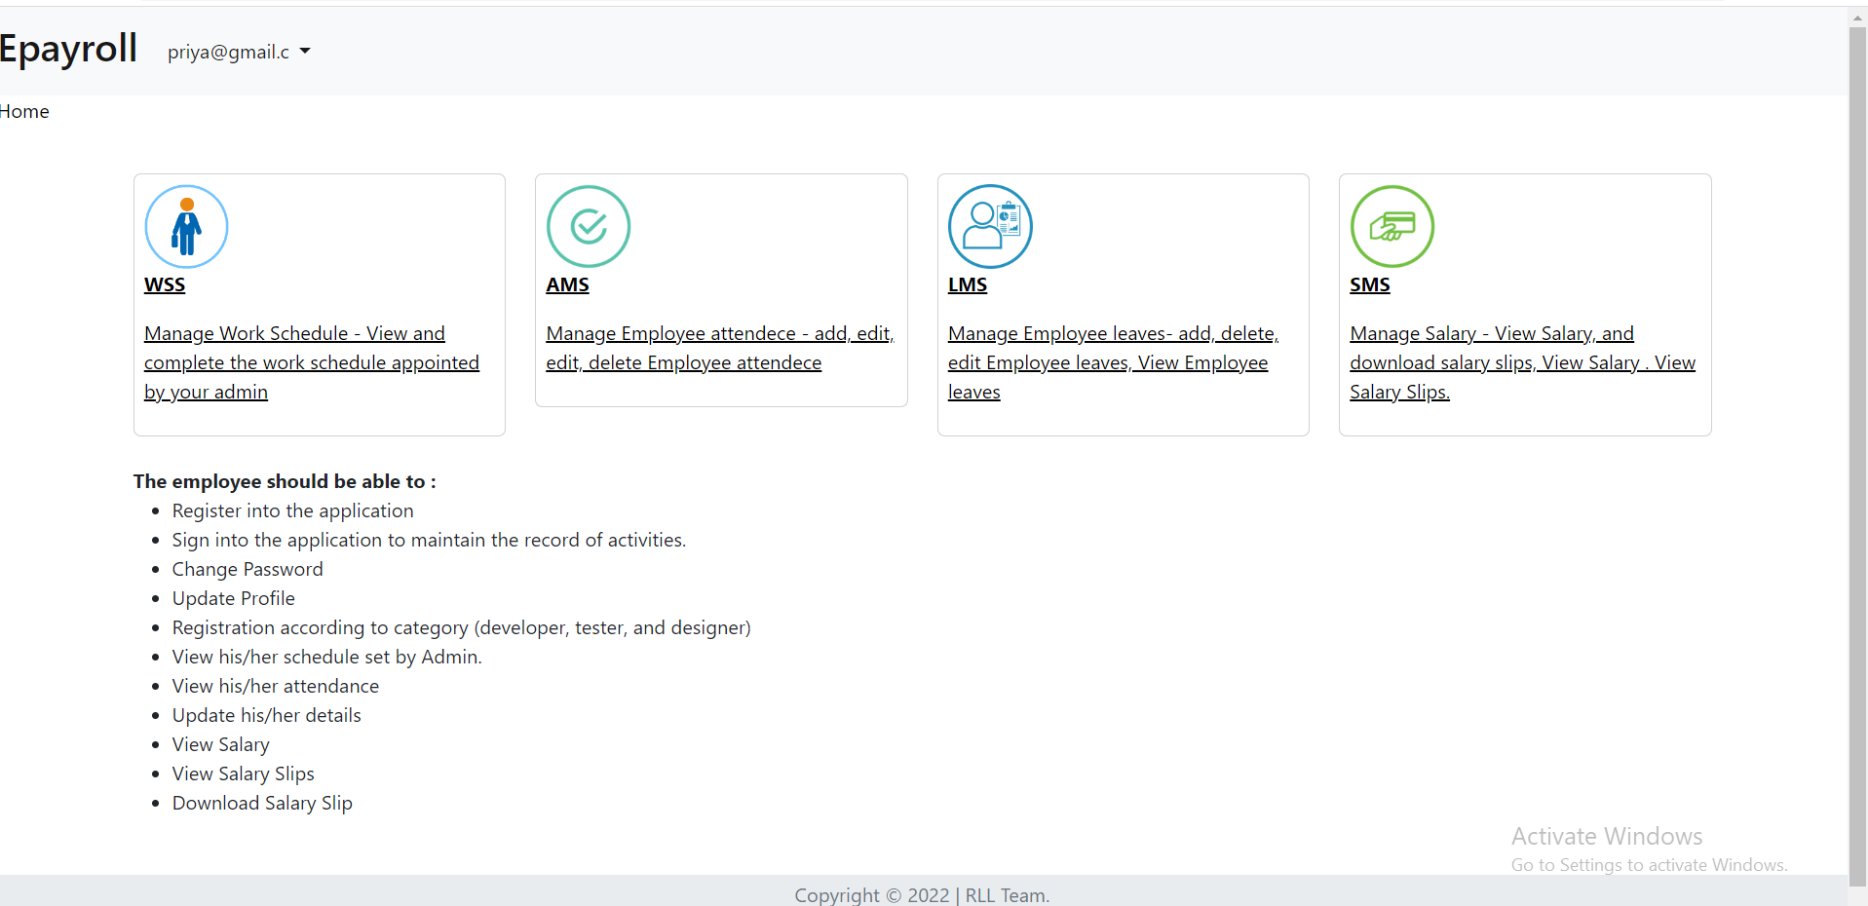
Employee dashboard

Slide 49
Change Password (Employee)
Employee can change his/her password
To change the password, employee must login to the portal.
Using the registered phone number and password, employee can change the password.
If the given phone number is not same as the register phone number then it throws an error which says phone number does not match.
If the phone number is valid and password is valid it shows password changed successfully.

Slide 50
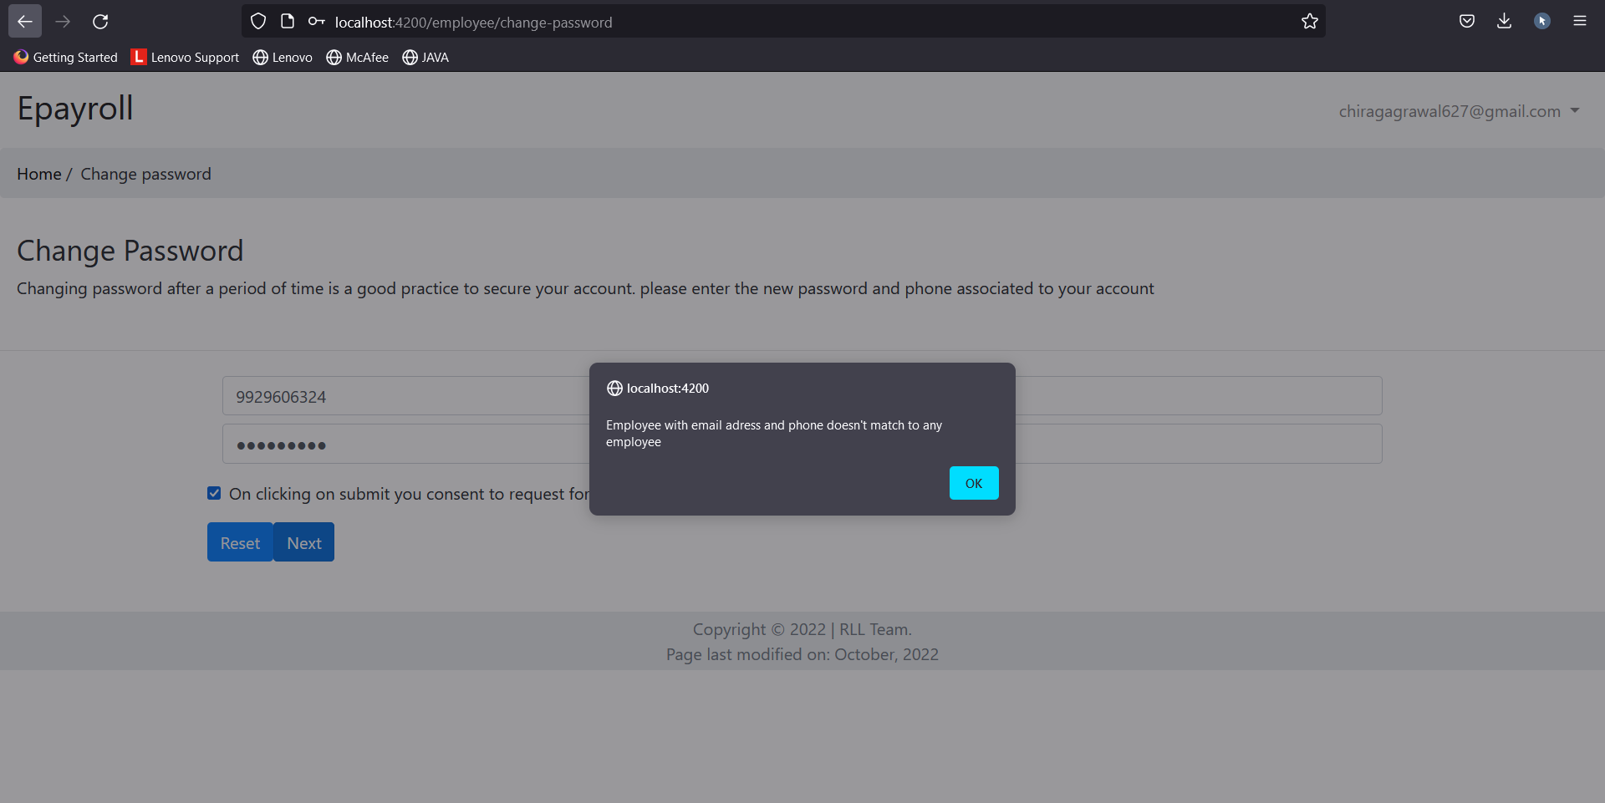
With incorrect phone number

Slide 51
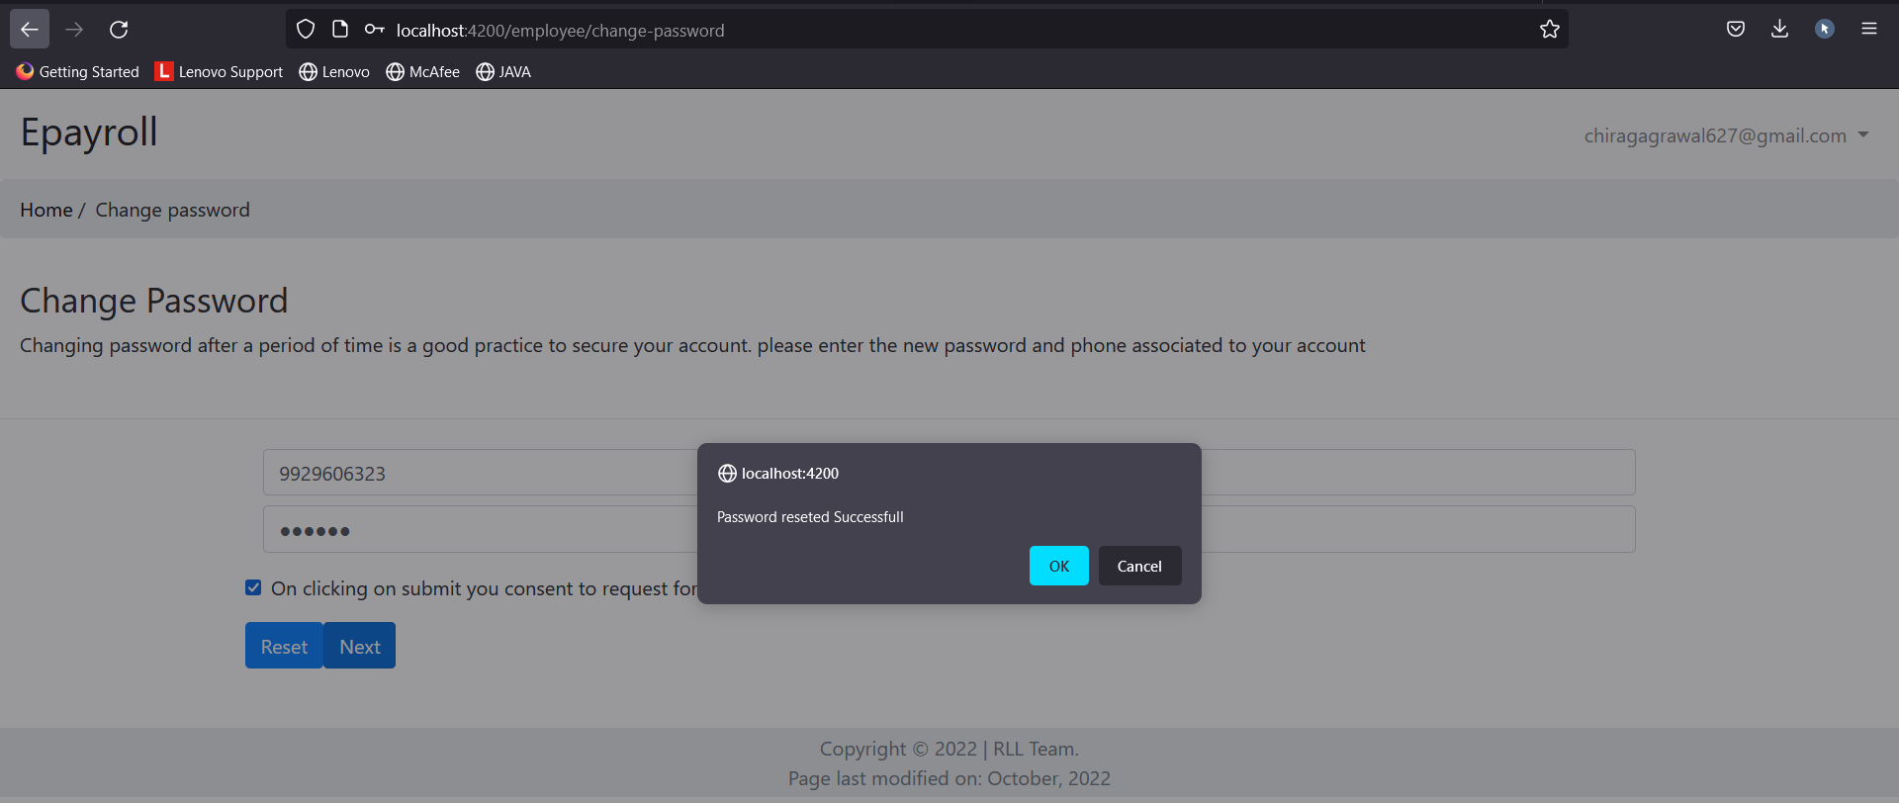
With correct phone number

Slide 52
Update Profile (Employee)
On this page employee can edit his/her details.
Employee can edit his details like first name, last name, designation, Gender, age, joining date.
Employee cannot edit the details like email and phone number due to security and consistency reasons.

Slide 53
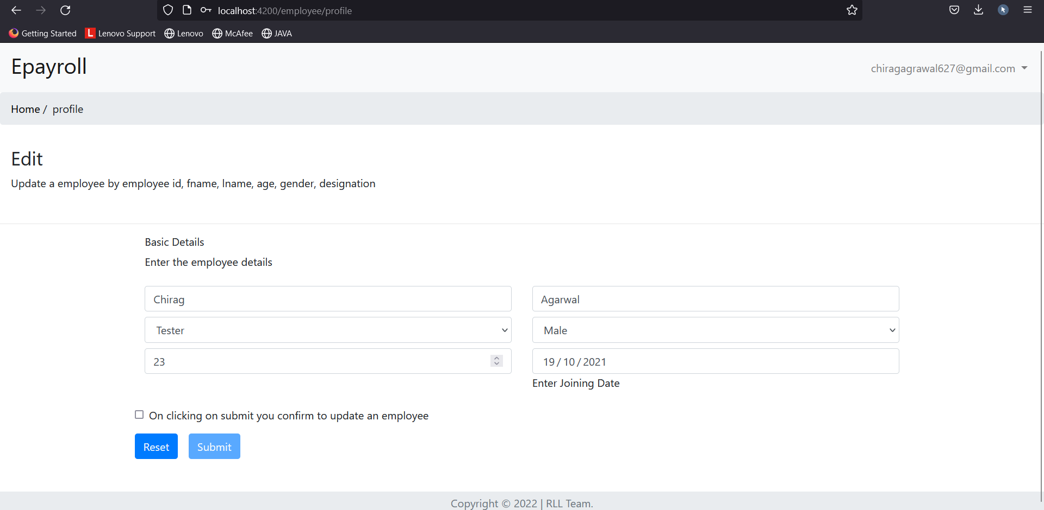
Update Profile (Employee)

Slide 54
Work Schedule System (WSS - Employee)
Features of WSS - Employee:
View the Work schedule
Employee can view the work schedule created by admin and check the status of his work i.e pending, completed, not completed set by the admin.

Slide 55
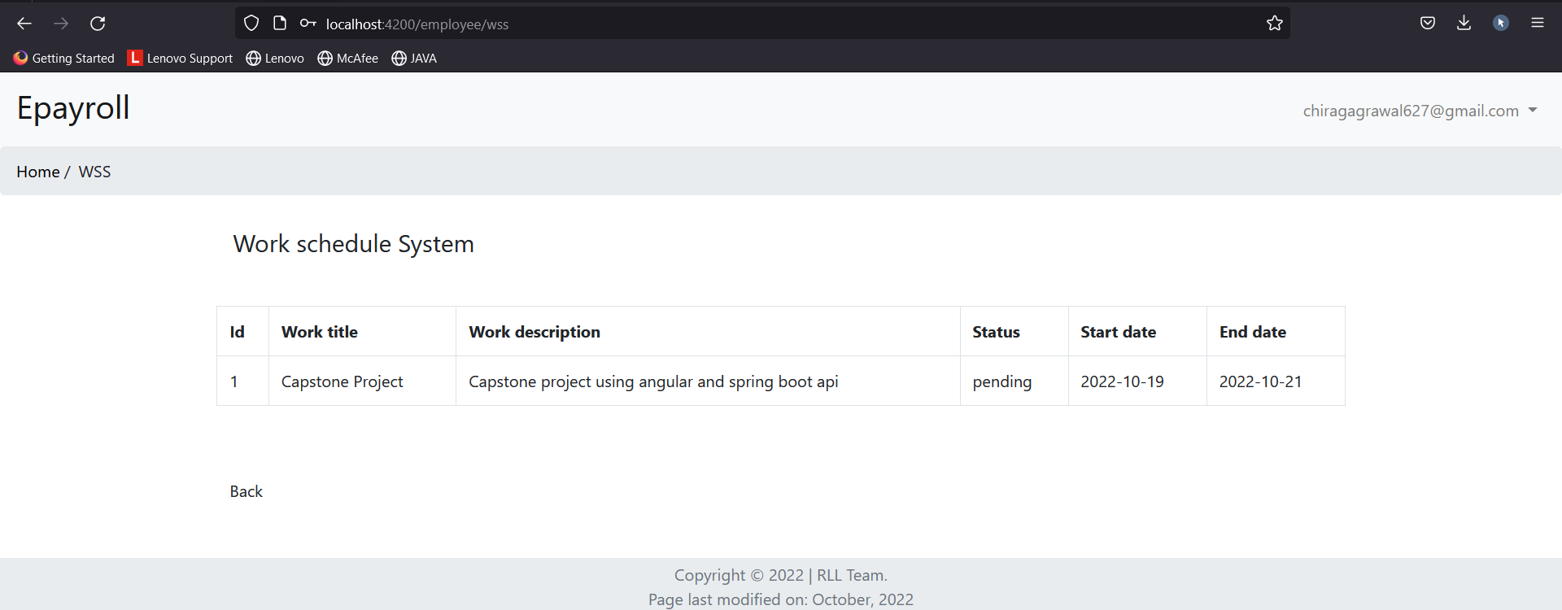
View Work Schedule System (WSS - Employee)

Slide 56
Attendance Management System (AMS-Employee)
Features of AMS - Employee:
View the Attendance Management System.
Employee can view the Attendance created by admin and check the status of attendance, i.e Present or Absent set by the admin.

Slide 57
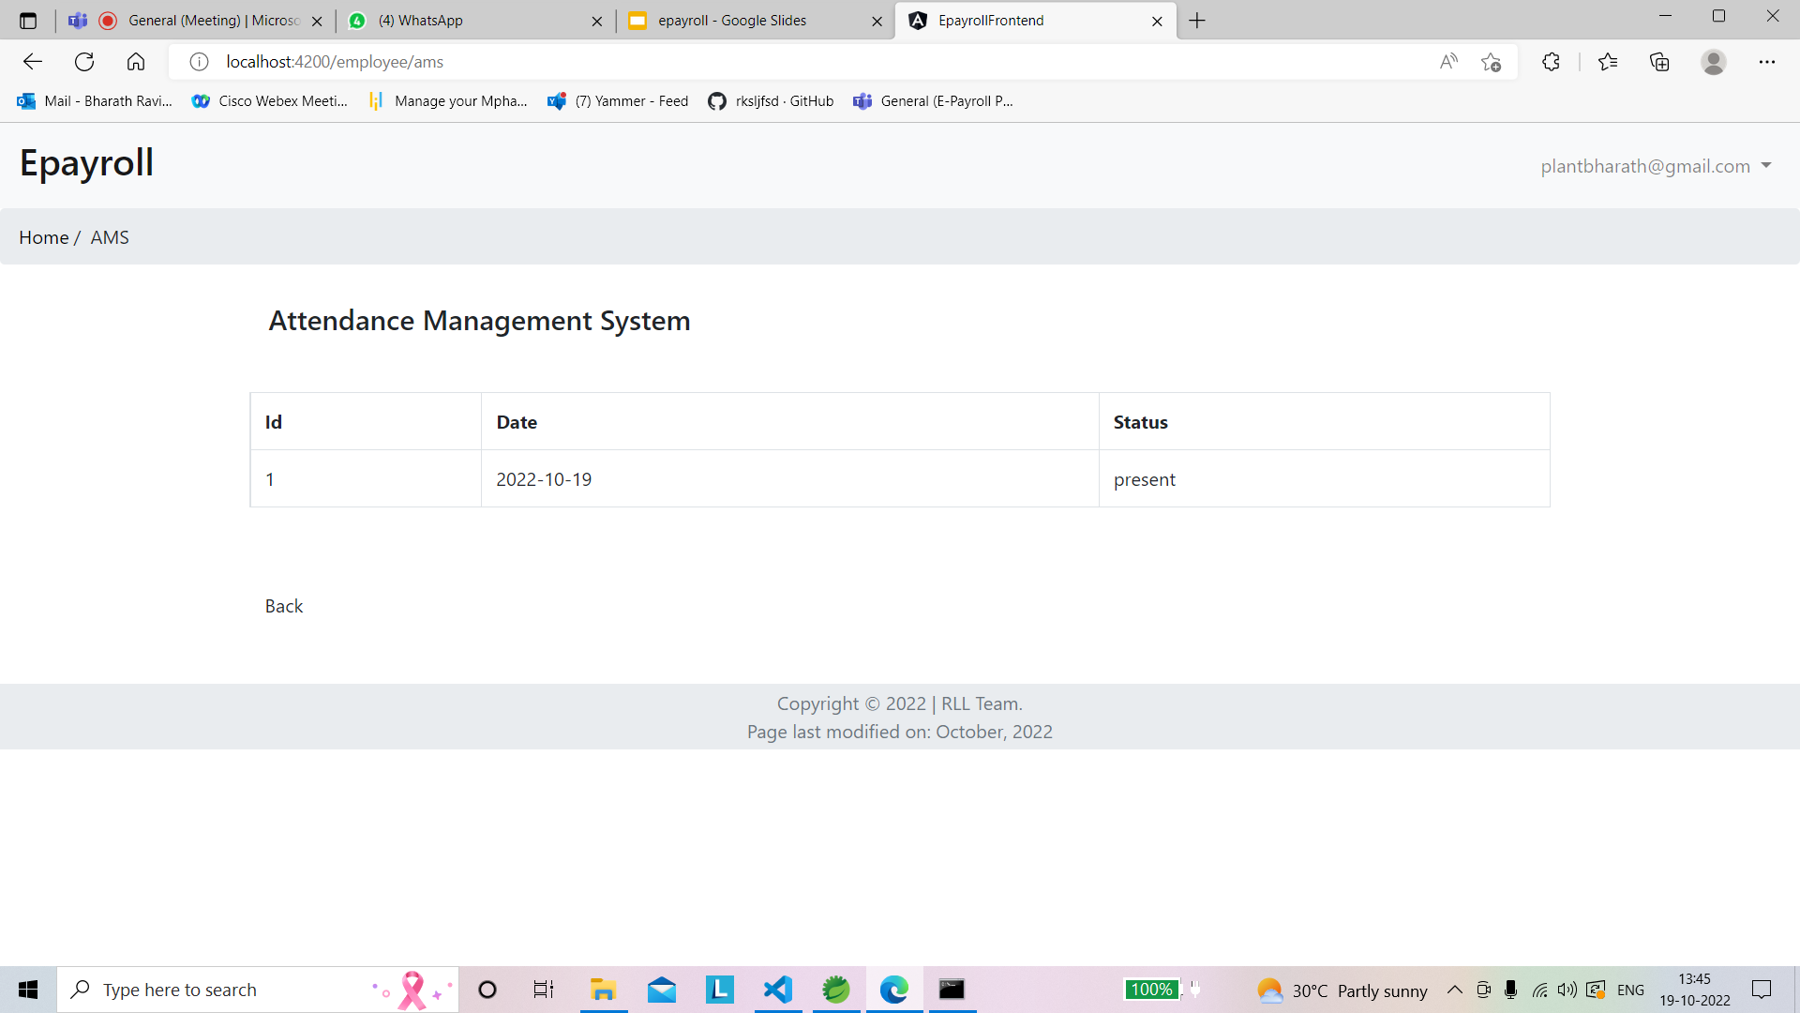
View Attendance Management System (AMS-Employee)

Slide 58
Leaves Management System (LMS- Employee)
Features of LMS - Employee:
Add Leaves/View status of leave.
When Employee enters the Lms portal , he has option to create a Leave request.
The Employee has to specify the dates & reasons for the leave in the leave request form.
On clicking the Submit button, the leave request has been created and it will be in pending status until admin take specific action .
Once the action taken by admin then the employee can see whether his leave request got approved or rejected.

Slide 59
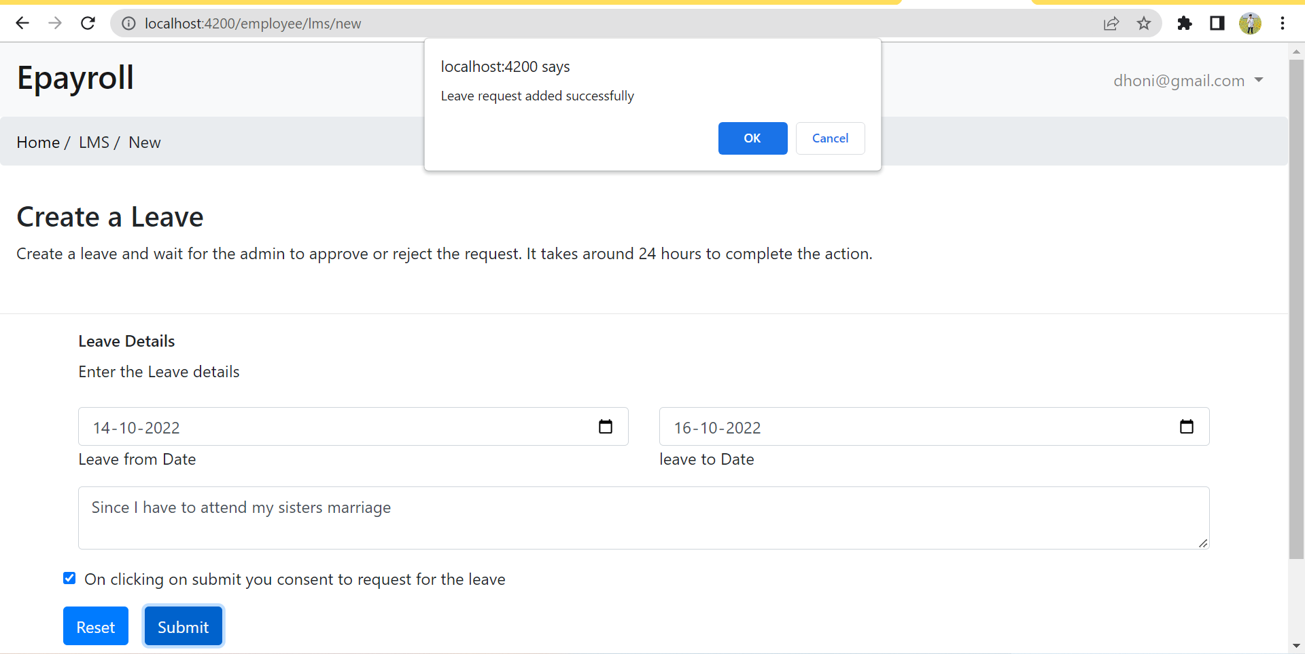
Leaves Management System (LMS- Employee)

Slide 60
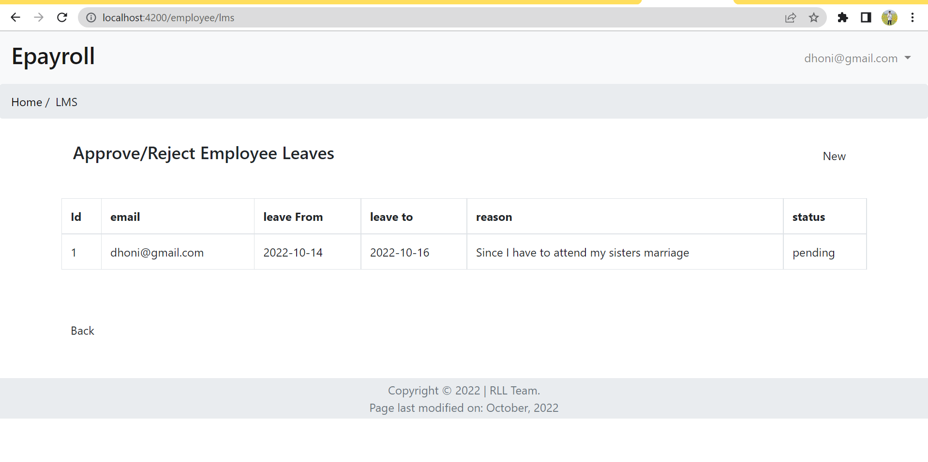
Leaves Management System (LMS- Employee)

Slide 61
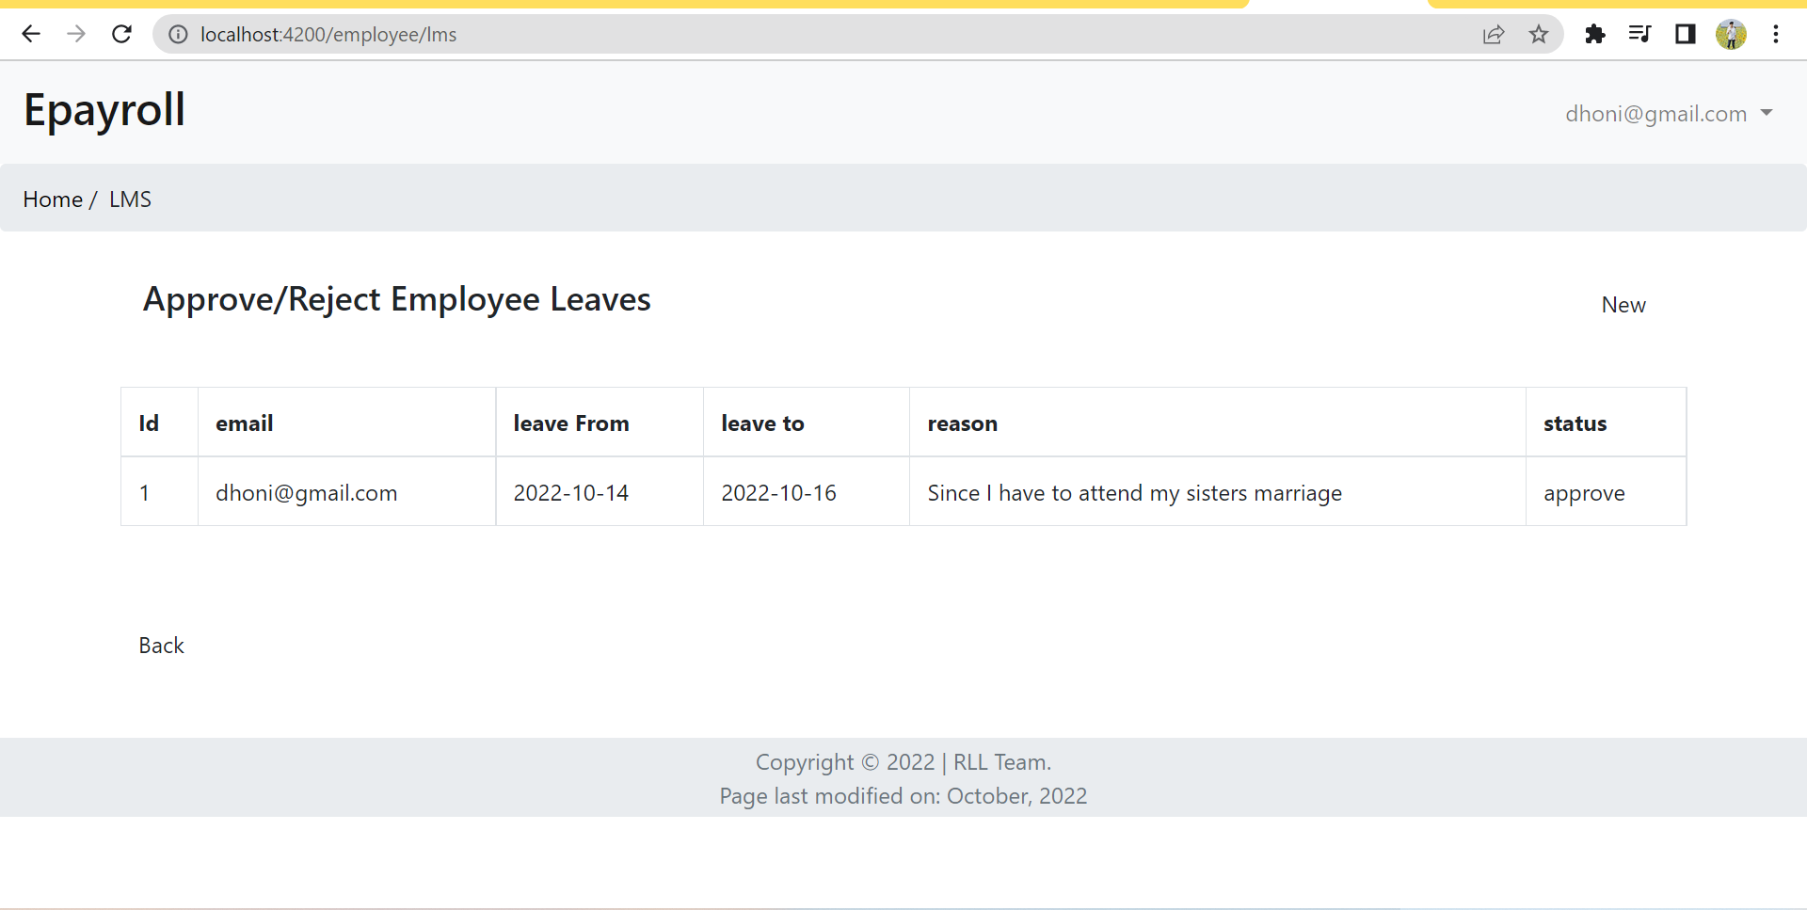
Employee leave approval

Slide 62
Salary Management System (SMS-Employee)
In employee portal of SMS, employee can view his/her own salary that admin has created
In addition to that, there is payslip section where an employee can select the month from the drop down menu and can view the pay slip of that particular month.
There is an option like download payslip where an employee can download the payslip in pdf format for the chosen month.

Slide 63
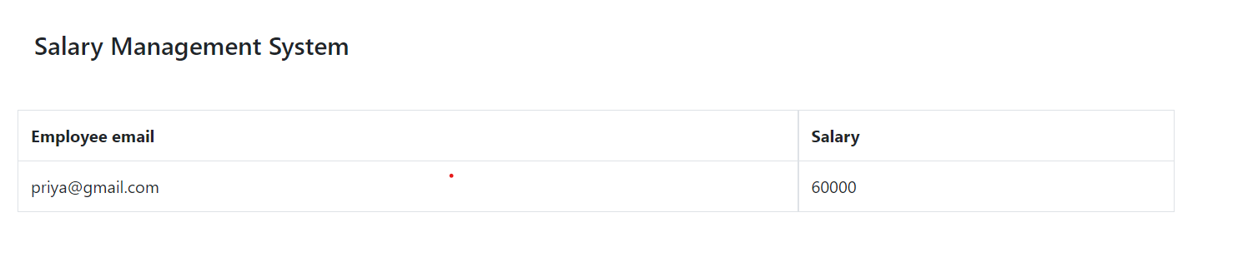
Salary Management System (SMS-Employee)

Slide 64
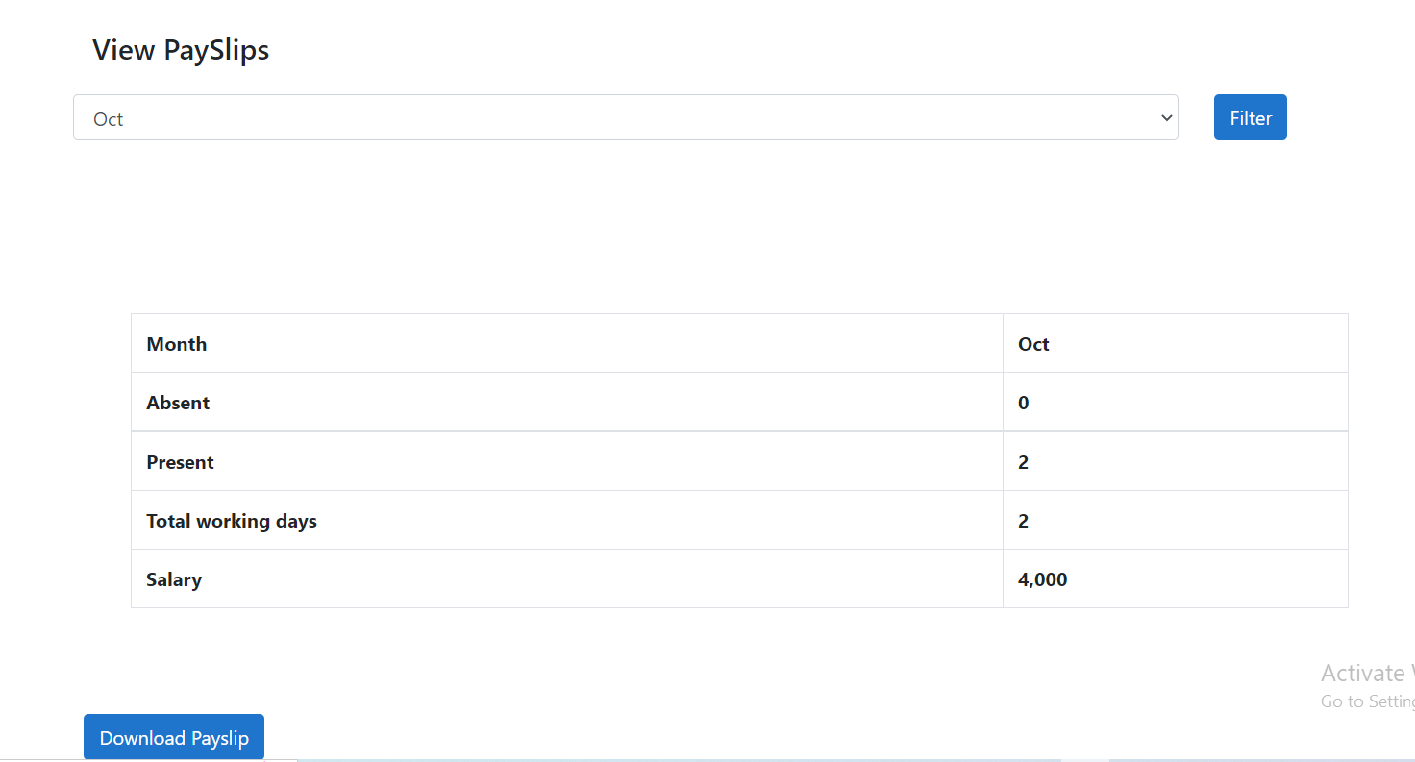
Salary Management System (SMS-Employee)

Slide 65
List of APIs
Admin Login Api : http://localhost:8081/admin/login
Employee Login Api : http://localhost:8081/employee/login
Employee SignUp Api : http://localhost:8081/employee/signup
Employee Reset Api : http://localhost:8081/employee/reset
Delete Employee By Id : http://localhost:8081/employee/id
Get Employee By Id : http://localhost:8081/employee/id
Update Employee :http://localhost:8081/employee
Post Employee : http://localhost:8081/employee
Post Attendance :http://localhost:8081/attandance
Delete Attendance By Id : http://localhost:8081/attandance/id
Get Employee Attendance By Email : http://localhost:8081/attandance/emailOfEmp
Post Attendance By Status : http://localhost:8081/attandance/status
Get Leaves Of Employee : http://localhost:8081/leaves

Slide 66
List OF APIs
Post Leaves Of Employee : http://localhost:8081/leaves
Get Leaves of Employee By Email: http://localhost:8081/leaves/emp/emailOfEmp
Get Employee Salaries : http://localhost:8081/salary
Post Employee Salaries : http://localhost:8081/salary
Delete Employee Salary By Id : http://localhost:8081/salary/id
Get Employee Salary By Id : http://localhost:8081/salary/id
Update Employee Salary :http://localhost:8081/salary
Get Employee Salary By Email : http://localhost:8081/salary/emailofemp
Get Employee Work Schedule : http://localhost:8081/work
Post Employee Work Schedule : http://localhost:8081/work
Delete Employee Work Schedule By Id : http://localhost:8081/work/id
Get Employee Work Schedule By Id : http://localhost:8081/work/id
Update Employee Work Schedule : http://localhost:8081/work
Get Employee Work Schedule By Email:http://localhost:8081/work/emp/emailofemp

Slide 67
Unit Testing
Unit Testing is defined as a type of software testing where individual components of a software are tested.
Unit Testing of the software product is carried out during the development of an application.
An individual component may be either an individual function or a procedure.

Slide 68
Regression-Testing Framework
JUnit is a regression-testing framework that developers can use to write unit tests as they develop systems.
This framework creates a relationship between development and testing. You start coding according to the specification & need after that use the JUnit test runners to verify how much it deviates from the intended goal.
This really helps to develop test suites that can be run any time when you make any changes in your code.
This all process will make you sure that the modifications in the code will not break your system without your knowledge

Slide 69
Why use JUnit?
JUnit provides also a graphical user interface (GUI) which makes it possible to write and test source code quickly and easily.
To write and run repeatable tests.
Programmers normally write their code, then write tests for it. Better to write tests while writing code.
JUnit provides a framework to keep tests small and simple to test specific areas of code.
JUnit shows test progress in a bar that is green if testing is going fine and it turns red when a test fails.
We can run multiple tests concurrently. The simplicity of JUnit makes it possible for the software developer to easily correct bugs as they are found.

Slide 70
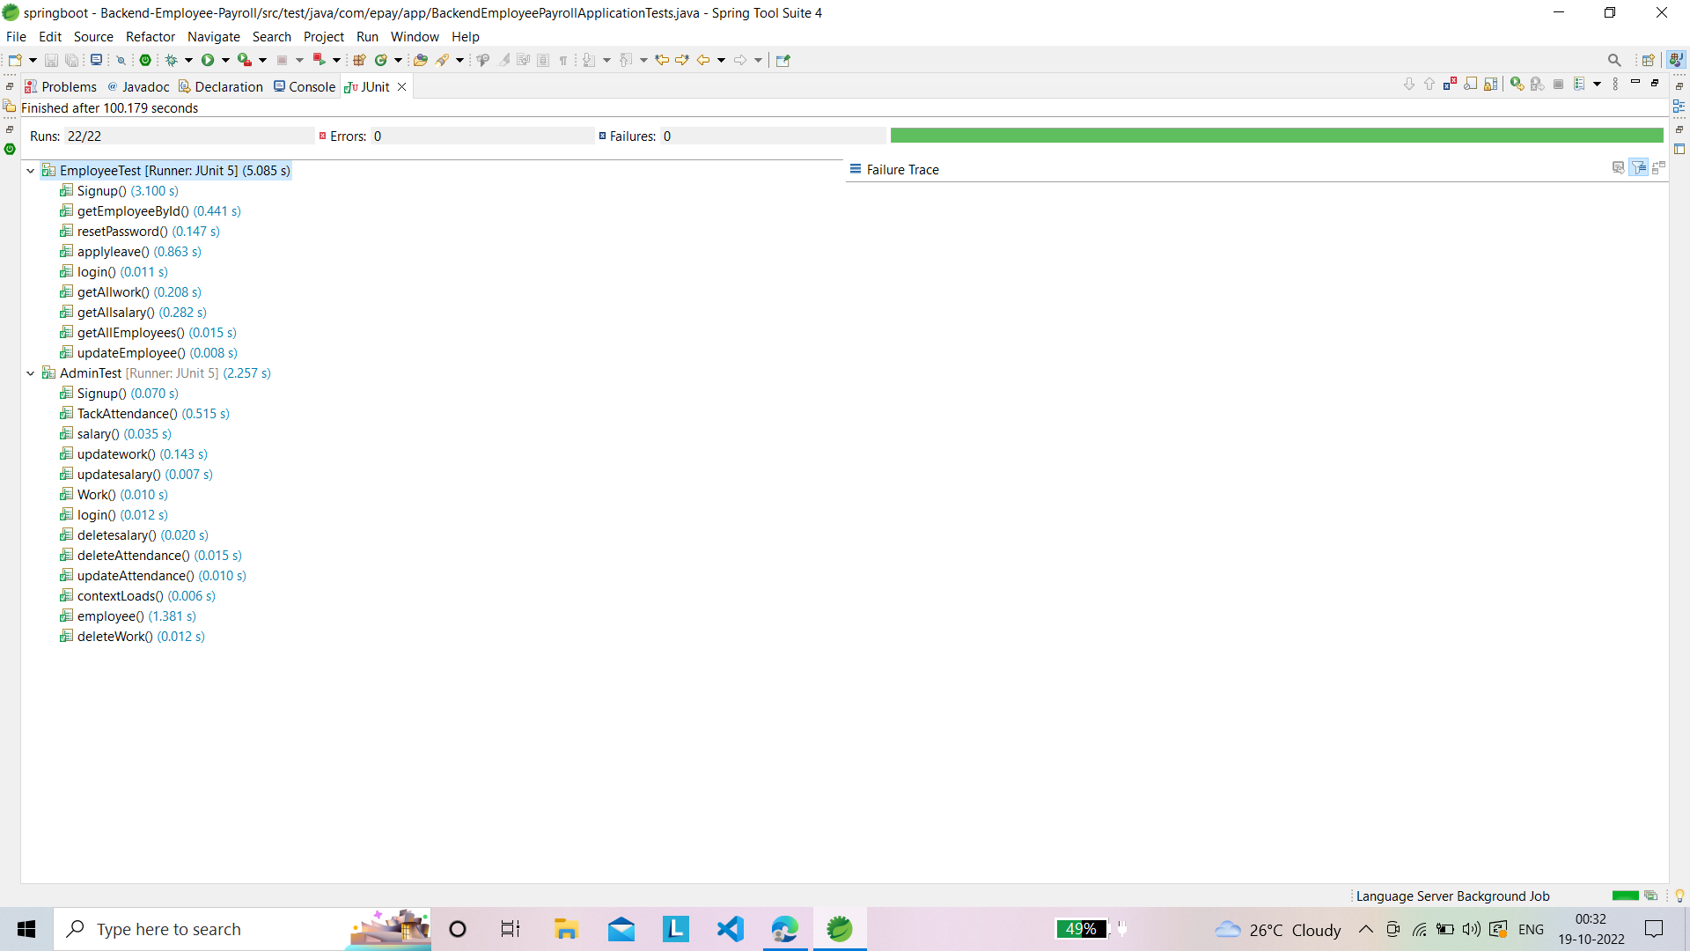
JUnit Testing:
JUnit Testing Output:

Slide 71
Future scope
This project has many future applications like it can be used in any of the Retail Outlet of Any Type companies.
This project was build keeping in mind all the requirements of these outlets and they can be implemented in any such type of organization with very few modifications.

Slide 72
Conclusion
“Employee Payroll Management System” is developed to achieve maximum efficiency and reduce the time taken to handle the Payroll activity.
It is designed to replace an existing manual record system thereby reducing time taken for calculations and for storing data.
The implementation of the system in the organization will considerably reduce data entry, time and also provide readily calculated reports.

Slide 73
Thanks
Do you have any questions?

